Slide 1
UFO Blog
Christobal & Jónes

Slide 2
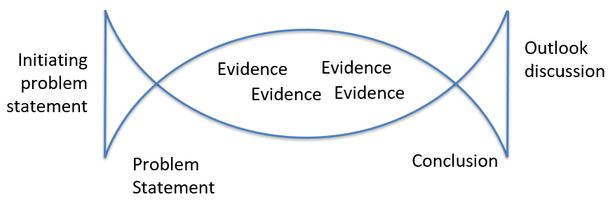
The Structure of the blog and this Powerpoint
* That’s how we learned to do so.
* The benefit - Gives a red line.

Slide 3
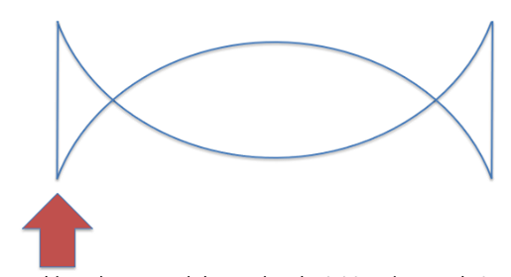
initiating problem statement & narrowing phase
* Kind of 2 in 1.
* Start out very broad orientated * We Choose to think about the way we store and use data * Then dove more into it and talked about dictionaries
* We care about the smallest details.

Slide 4
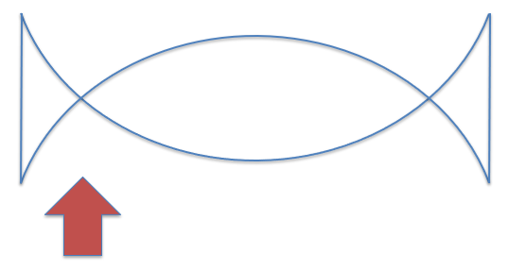
The Problem statement
* “When is it faster to use a foreach rather then a dictionaries key to search for chosen element.”
* A specific problem we want to answer.
* Next step
Plan of execution, Why is it handy?

Slide 5

The plan of execution
* Experiment 1
The purpose of experiment one is to declare that there even exists a difference between the response time.
* Experiment 2
The purpose of experiment two is to find out how big collection can be before it has a slower response time

Slide 6
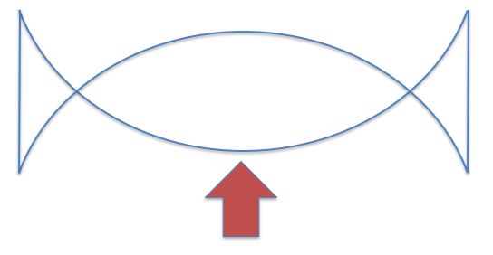
The Experiments
* Now we have to garther as much data as we need to make a conclusion.

Slide 7
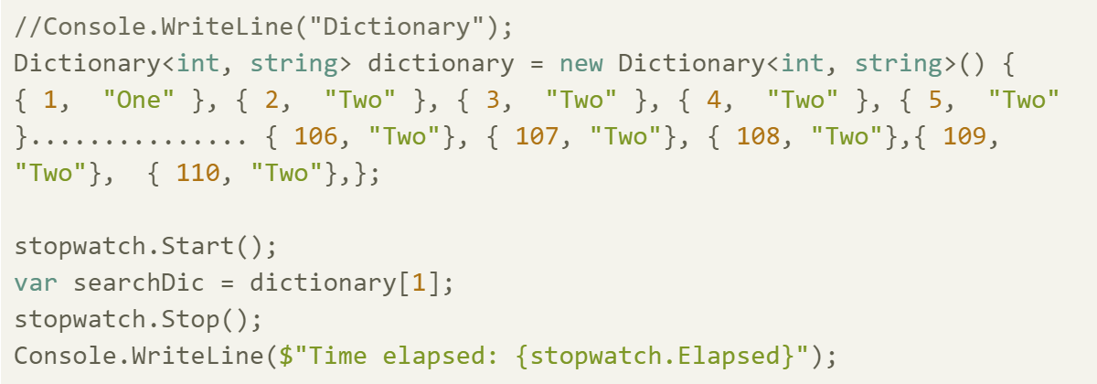
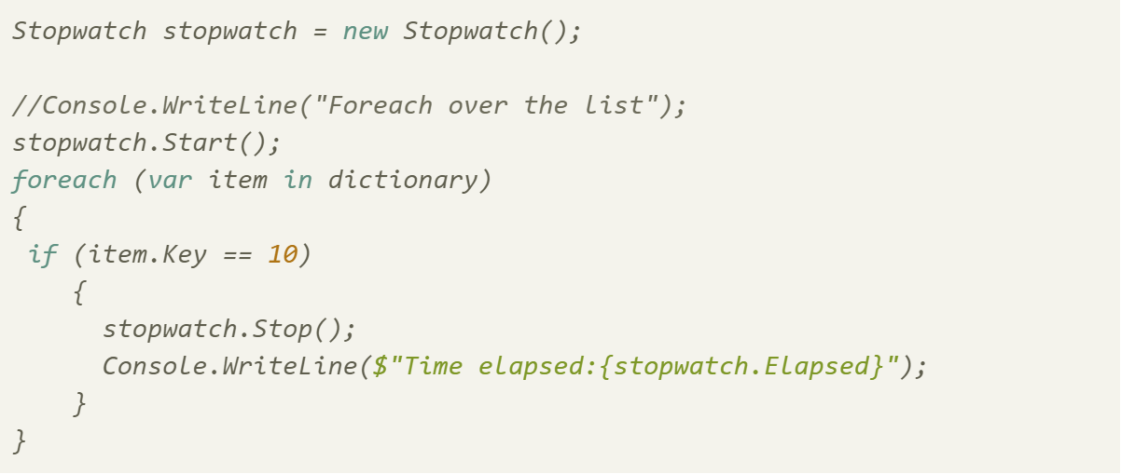

Experiment 1.
* The wanted to test with the first element, so we had to run the foreach the lowest possible time.
* We found, that there indeed was a difference.

Slide 8
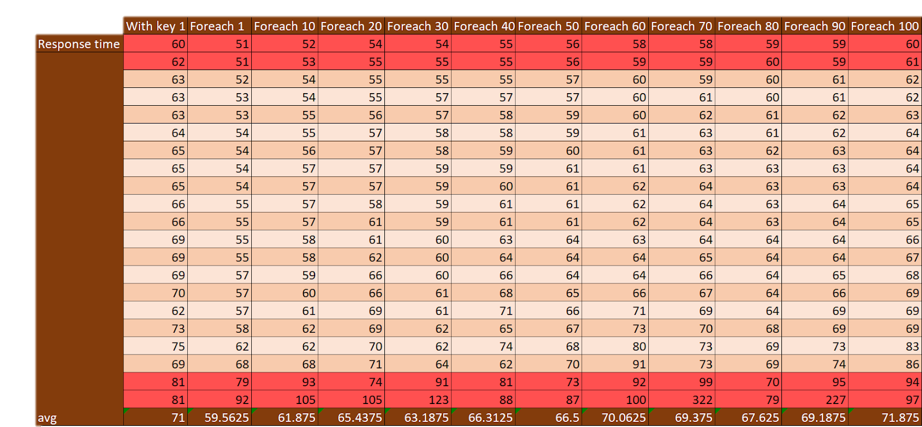
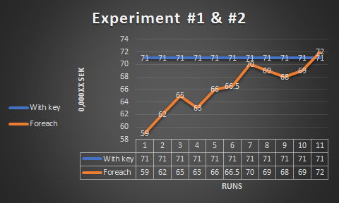
Experiment 2.
* Just a matter of collecting all the data.
* We tried to write some code, which would run through it 10.000 time and give us the average = problem

Slide 9

cONCLUESION
* Based on the experiments we did and the all data we got.
* The answer is: 100 elements. With a difference up to 0.000012 sec

Slide 10

Reflecsion
This is a very small difference, but I can still mean a lot, in systems were
* In modern sociaty very secound, millisecound, mikrosecound and even nano secounds matters.

Slide 11
Version 1. vs version 2.

Slide 12
Feedback

